Slide 1
Towards Authentic and Trustworthy Online Conversations: A Unified Detection Model
Presented by:
TWON Group B1: Metrics

Slide 2
Table of Contents
Why Are We Doing This?
Introduction
Problem Statement
Hypotheses
Research Questions
Experimental Setup
Workflow
Conclusion
References
Q&A

Slide 3
The Call to Action: Why Are We Doing This?
1. Misinformation Epidemic:
Fake news propagates at alarming speeds, manipulating opinions and dividing societies.
Without reliable detection systems, the narratives go unchecked.
2. Rising Hate Speech:
Online platforms have become spaces where harmful speech spreads, dividing communities and putting people in danger.
Accurate hate speech detection systems are critical for moderation and fostering inclusive spaces.
3. Unchecked Toxicity:
Toxic behaviors discourage healthy debates, silencing users and deterring engagement.
Tackling toxicity helps rebuild trust in online platforms.

Slide 4
Introduction
Towards Authentic and Trustworthy Online Conversations
Social media platforms help people connect and share information worldwide.
Hate speech spreads negativity, divides communities, and harms relationships.
Fake news misleads people, damages trust and creates confusion.
Toxicity in conversations escalates conflicts and creates unhealthy online environments.
Tackling all these issues together is important to make online spaces safer and rebuild trust.

Slide 5
Problem Statement
Hate Speech Spreading Misinformation
Fake News Amplifies Hate Speech
Toxicity Incites Misinformation and Hate Speech

Slide 6



Real World Examples
Hate Speech:
People from that group A should not be allowed here.
Fake News:
The city is shutting down all schools forever.
Toxicity:
Your work is awful and useless.
Fake News Amplifying Hate Speech:
A fake news story about a political group committing crimes can
lead to hate speech targeting members of that group.
Toxicity as a Response to Fake News:
Users reacting to misinformation with toxic comments, escalating
conflicts in online discussions.
Hate Speech Spreading Misinformation:
Hate speech posts may include false claims about a community,
blending fake news with harmful rhetoric.

Slide 7
Hypotheses
Shared Representations: Fake news, toxicity, and hate speech share linguistic and contextual cue. A unified model can leverage these overlaps for better robustness.
Multitask Learning: Combining datasets frames the problem as multitask learning, enabling the model to generalize across tasks and improve performance.
Enhanced Explainability: Training on diverse tasks helps the model uncover nuanced patterns, improving prediction explanations.
Fake News: "Media outlets are hiding the truth about the election results!“ Toxicity: "Stop believing the lies from mainstream media, you sheep!“ Hate Speech: "Those journalists are all corrupt traitors who should be dealt with!"

Slide 8
Research Questions
a) How does the performance of separate transformer models, each trained individually on fake news, hate speech, and toxicity datasets, compare to that of a single unified transformer model trained on all three datasets together?
b) Which approach yields better results for combined detection tasks?
What conclusions can be drawn from the combined detection of fake news, toxicity, and hate speech? How can this contribute to fostering informed public engagement and improving the quality of social media?

Slide 9

Objectives
Evaluate
Evaluate Multi-task Learning
Optimize
Optimize Model Performance
Assess
Assess Societal Impact

Slide 10
Experimental Setup
Data Collection
Data
Pre-processing
Model Selection
Model
Fine-Tuning
Evaluation of Results
Comparison
Prompting

Slide 11

Dataset
DeFaktS- Fake News Detection
Gahd – Hate Speech Detection
Multilingual toxicity dataset (DeTox-Dataset, GemEval 2018, 2021) – Toxicity Detection

Slide 12
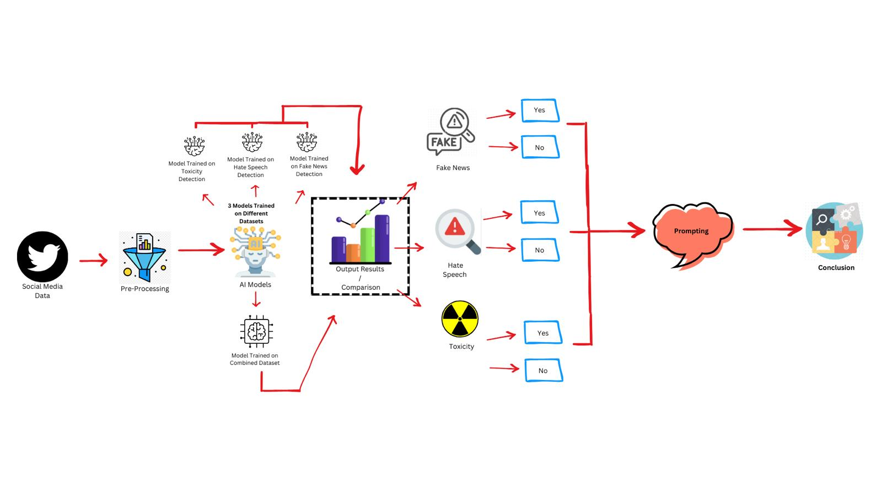
Workflow

Slide 13

Expected Outcomes
Enhanced detection capabilities.
Unified models demonstrating reduced computational overhead compared to separate detection systems.
Improved accuracy in identifying fake news, hate speech, and toxicity, both individually and when overlapping.
Ensures transparency, builds trust in the model's predictions, and helps users understand the reasoning behind decisions, making the system more credible and actionable.

Slide 14
Conclusion
This research will help identify the best way to detect fake news, hate speech, and toxicity simultaneously.
It will analyze whether separate or unified models perform better for combined detection tasks.
Findings will show how better detection methods can make online spaces safer and encourage healthy public discussions.

Slide 15
References
DeFaktS: A German Dataset for Fine-Grained Disinformation Detection through Social Media Framing
Improving Adversarial Data Collection by Supporting Annotators: Lessons from GAHD, a German Hate Speech Dataset
Multilingual toxicity dataset (DeTox-Dataset, GemEval 2018, 2021) – Toxicity Detection

Slide 16

Questions & Answers

Slide 17
Expected Challenges
Data Imbalance: One dataset might dominate learning, skewing results.
Task Interference: Some tasks might negatively influence others, reducing overall performance.
Explainability Trade-offs: Increasing explainability might slightly reduce raw performance

Slide 18
Thank You

